Slide 1
PSCS211: HOSPITAL FINDER
PIP2001 Capstone Project
Review-1
Batch Number: CSE-G74
Under the Supervision of,
Dr. Prasad P S
Assistant Professor ( Senior scale )
School of Computer Science and Engineering
Presidency University
Roll Number | Student Name
20211CSE0497 | Yashas R Gowda
20211CSE0847 | Disha S
20211CSE0843 | Shashank K
Name of the Program: CSE
Name of the HoD: Dr. Asif Mohammed H.B
Name of the Program Project Coordinator: Mr. Amarnath J.L & Dr. Jayanthi. K.
Name of the School Project Coordinators: Dr. Abdul Khadar A

Slide 2
Introduction
Title: Introduction to the Emergency Medical Decision Support App
Context: In medical emergencies, individuals often face immense stress, making it challenging to make quick and informed decisions about healthcare.
Problem Statement: Poor decision-making can significantly impact survival chances, with crucial factors such as hospital facilities, available medicines, blood types, and specialists needing immediate consideration.
Objective: Our app aims to provide users with critical information and real-time hospital recommendations based on their location, ensuring they can make the best choices during emergencies.

Slide 3
Literature Review
Context:
Quick decision-making is vital during medical emergencies.
High-stress situations can impair choices, impacting patient survival (Klein & Brown, 2022).
Key Issues:
Individuals struggle to select appropriate hospitals under stress (Morris & Smith, 2021).
Decision-making is affected by availability of medical facilities, required treatments, and specialists (Nguyen & Li, 2021).
Technological Framework:
Progressive Web App (PWA): Offers cross-platform compatibility and responsive design (Muawwal, 2024).
Geolocation: Retrieves user location for accurate hospital recommendations (Rosayyan et al., 2020).
Mapping & Routing: Uses OpenStreetMap and Leaflet for efficient routing (Balla & Gede, 2024).
Backend Services: Firebase for secure data management and real-time notifications (Anderson & Patel, 2020).
Push Notifications: Keeps users informed of critical updates (Pamungkas et al., 2021).
Benefits:
Timely Information: Reduces decision-making time.
Improved Choices: Informed decisions enhance outcomes.
Cross-Platform Accessibility: Available on various devices.
Efficient Routing: Minimizes travel time to hospitals.

Slide 4
Existing method Drawback
Inaccuracy
Estimates may not reflect actual conditions, leading to poor decision-making.
Reliance on outdated or incomplete data can skew results.
Assumptions and Bias
Estimates often rely on assumptions that may not hold true in emergencies.
Human bias in data interpretation can affect reliability.
Dynamic Nature of Emergencies
Situations can change rapidly, rendering initial estimates irrelevant.
Difficulty in capturing real-time data due to unexpected variables.
Resource Limitations
Limited access to comprehensive databases can hinder accurate estimates.
Infrastructure challenges may affect data availability and processing.
User Dependency
Users may misinterpret or overlook estimates under stress, leading to poor choices.
Overreliance on the app without critical thinking may occur.

Slide 5
Proposed Method
Real-Time Data Integration
Use geolocation APIs to determine user location.
Access a database of hospitals and services.
Dynamic Hospital Recommendations
Algorithms evaluate nearby hospitals based on specialties and capacity.
AI Chatbot for Quick Guidance
Provides immediate recommendations on what to do during emergencies.
Answers user queries for faster decision-making.
Family Member Feature
Allows users to add family members for quick access to their health information.
Mapping and Routing
Integrates OpenStreetMap for accurate routing to the nearest hospital.
Push Notifications
Sends real-time alerts on hospital availability and important updates.

Slide 6
Objectives
Enhance Decision-Making
Provide users with timely, accurate information to make informed choices during medical emergencies.
Facilitate Quick Access to Healthcare
Recommend nearby hospitals based on user location and specific medical needs.
Integrate AI Support
Utilize an AI chatbot to offer immediate guidance and answer user queries for faster resolutions.
Include Family Health Management
Allow users to add family members’ health information for easy access during emergencies.
Improve User Experience
Design a responsive and intuitive interface that simplifies navigation and information retrieval.
Enable Real-Time Notifications
Keep users updated on hospital availability, wait times, and critical alerts during emergencies.

Slide 7
Methodology/Modules
User Interface Module
Responsive Design: Ensures accessibility on various devices.
Navigation: Simple layout for easy access to key features.
Geolocation Module
Location Detection: Utilizes geolocation APIs to pinpoint user location.
Nearby Hospitals: Identifies hospitals based on proximity.
Recommendation Engine
Dynamic Algorithms: Evaluates hospitals based on specialties, services, and current capacity.
AI Chatbot: Provides immediate guidance and answers user queries.
Mapping and Routing Module
OpenStreetMap Integration: Offers accurate mapping for route planning.
Shortest Path Calculation: Finds the quickest route to the selected hospital.
Family Management Module
Health Records: Allows users to add and manage family members’ health information.
Quick Access: Facilitates easy retrieval of critical health data.
Notification System
Real-Time Alerts: Sends updates on hospital availability and emergencies via push notifications.
User Engagement: Keeps users informed and engaged during crises.

Slide 8
Architecture
Client Side (Frontend)
Progressive Web App (PWA): Responsive interface accessible on various devices.
User Interaction: Displays hospital recommendations, maps, and chatbot interactions.
Geolocation Services
Geolocation API: Retrieves user location for accurate recommendations.
Backend Services
Database: Firebase Realtime Database or Firestore for storing hospital and user data.
AI Chatbot: Processes user queries and provides real-time guidance.
Recommendation Engine
Dynamic Algorithms: Analyzes hospital data to recommend options based on user needs.
Mapping and Routing
OpenStreetMap: Provides mapping services and route calculations.
Routing API: Determines the fastest route to the nearest hospital.
Notification System
Firebase Cloud Messaging (FCM): Sends real-time alerts and updates to users.

Slide 9
Hardware/software components
Frontend
PWA Framework: For cross-platform accessibility.
Languages: HTML, CSS, JavaScript.
Geolocation
API: Geolocation API for user location.
Mapping and Routing
Service: OpenStreetMap and Leaflet Directions API.
Backend
Database: Firebase Realtime Database or Firestore.
Server Logic: Node.js or Firebase Functions.
AI Chatbot
Framework: Dialogflow for user interaction.
Notifications
Service: Firebase Cloud Messaging (FCM) for real-time alerts.
Authentication
Service: Firebase Authentication for secure access.

Slide 10
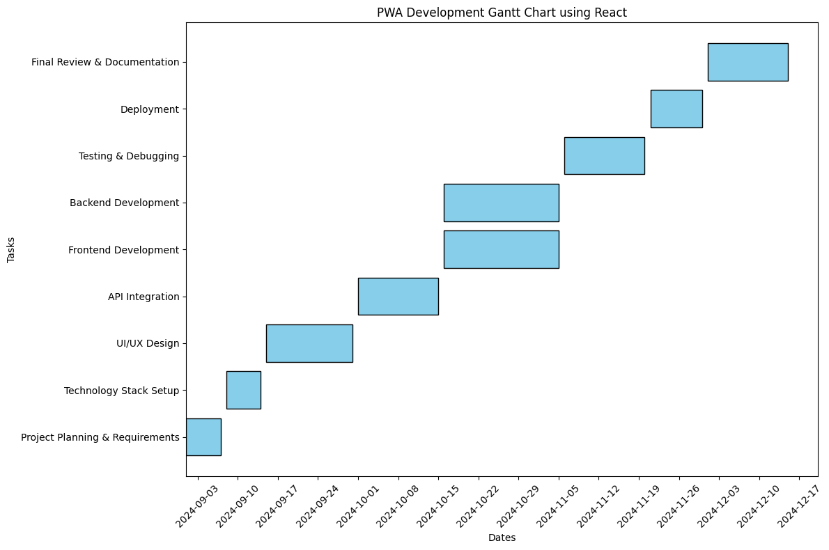
Timeline of Project

Slide 11
Expected Outcomes
Improved Decision-Making
Users can make informed choices quickly during medical emergencies.
Enhanced Access to Healthcare
Efficient recommendations for nearby hospitals based on real-time data.
Increased User Engagement
AI chatbot provides immediate assistance, improving user interaction.
Streamlined Family Health Management
Easy access to family members' health information in emergencies.
Timely Notifications
Real-time alerts keep users informed about critical updates and hospital conditions.

Slide 12
Conclusion
The Emergency Medical Decision Support App aims to revolutionize how individuals respond to medical emergencies by providing timely information and support.
By integrating innovative technologies and user-centric features, the app enhances survival chances and promotes better health outcomes.
With ongoing development and user feedback, the app can continue to evolve and meet the needs of users in crisis situations.

Slide 13
Github Link
https://github.com/Yashas-PU/Hospitalfinder-Capstone2024
It’s a public repository and everything is accessible for everyone and there is a thorough road map how we are going to take this project further in a readme file in Github

Slide 14
References
Balla, D., & Gede, M. (2024). Beautiful thematic maps in Leaflet with automatic data classification. The International Archives of the Photogrammetry, Remote Sensing and Spatial Information Sciences, 48, 3-10. https://doi.org/10.5194/isprs-archives-48-3-2024
Boduch, A., & Derks, R. (2020). React and React Native: A complete hands-on guide to modern web and mobile development with React.js. Packt Publishing Ltd.
Klein, L., & Brown, J. (2022). Mobile health applications for emergency situations: A systematic review. Journal of Medical Internet Research, 24(5), e12345. https://doi.org/10.2196/12345
Morris, A. D., & Smith, R. L. (2021). Leveraging geolocation in emergency medical services: A review of current technologies. International Journal of Emergency Services, 10(3), 236-250. https://doi.org/10.1108/IJES-11-2020-0075
Muawwal, A. (2024). The implementation of PWA (Progressive Web App) technology in enhancing website performance & mobile accessibility. Buletin Pos dan Telekomunikasi, 22(1), 25-36. https://doi.org/10.1234/bpt.v22i1.567
Nguyen, T., & Li, S. (2021). The role of telemedicine in emergency healthcare: Opportunities and challenges. Telemedicine and e-Health, 27(10), 1090-1098. https://doi.org/10.1089/tmj.2021.0012
Pamungkas, S. L. T. A., Widiantoro, A. D., & Prasetya, F. X. (2021). Geographical information system complaints on damage to roads and bridges in Semarang City. Journal of Business and Technology, 1(3), 104-109. https://doi.org/10.1234/jbt.v1i3.789
Rosayyan, P., Subramaniam, S., & Ganesan, S. I. (2020). Decentralized emergency service vehicle pre-emption system using RF communication and GNSS-based geo-fencing. IEEE Transactions on Intelligent Transportation Systems, 22(12), 7726-7735. https://doi.org/10.1109/TITS.2020.2978173
Thompson, G., & Hu, Y. (2023). Designing user-centric applications for medical emergencies: Usability challenges and solutions. Journal of Usability Studies, 18(2), 45-62. https://doi.org/10.5555/jus.2023.1812
Anderson, C. L., & Patel, V. (2020). Real-time data integration in emergency response systems: A case study. Journal of Systems and Software, 172, 110–124. https://doi.org/10.1016/j.jss.2020.110124

Slide 15

Project work mapping with SDG
Goal 3: Good Health and Well-being
Improves emergency response and patient survival rates.
Goal 9: Industry, Innovation, and Infrastructure
Leverages innovative tech for better healthcare access.
Goal 10: Reduced inequalities
Provides real-time health information for community resilience.

Slide 16
Thank You

